Slide 1
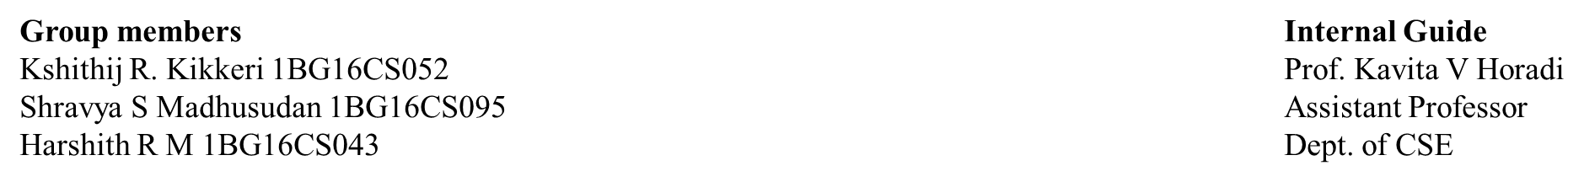
Controlling Adulteration in Public Food Grain Distribution

Slide 2
Outline
Introduction
Problem Statement
Literature Survey
Objective
Methodology
References

Slide 3
Introduction
India is an agriculture-based country which contributes around 17% of the GDP
Characteristically, there is a large amount of food grains produced by India which is stored by the Food Corporation of India(FCI)
A part of this vast amount of grains are reserved to be distributed to the poor and the needy by the Government through various schemes
There are a lot of loopholes which hamper the existing system which is highly influenced by the bureaucracy

Slide 4
Introduction
The food distribution system of the present day is bound to have various problems which are initiated at Fair Price Shops (FPS)
This includes malpractices by FPS dealers such as diverting the food allocated for BPL (Below Poverty Line)
Also there is no convenient method to identify these inferior quality grains which is used by the Government
Human perception has long been recognized as a guide to quality assessment but the results are not accurate and is unreliable.

Slide 5
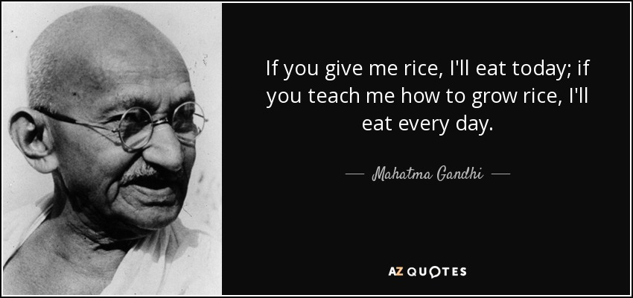

Slide 6
Problem Statement
The Traditional System to distribute the food grains in FPS is Obsolete and is not Liable. This system proves the inability of the bureaucratic setup which has failed to deliver good quality grains to the needy. The aim of this project is to overcome the failures of the present system and to design an automated grain recognition system which performs quality analysis of rice grains using its features and classifies the type of grain based on its quality.

Slide 7
Literature Survey
[1] Syed Ali et al, “Low Cost Solution for Rice Quality Analysis using Morphological Parameters and its Comparison with Standard Measurements” 20th International Multitopic Conference (INMIC’1) 978-1-5386-2303-9/17 ©2019 IEEE
The main aim of this research is to provide a low cost software product that mimics all the features and characteristics of this software
103 rice grains were taken for the classification of rice grains. Features which include length, width, area, uneven particles, grains of other colors are taken into consideration for classification
The results obtained in terms of percentage accuracy of average length and average width of rice grains are 95.04 and 95.45 respectively
Advantage: Provides a low cost solution for classification using advanced techniques
Disadvantage: Not reliable and not universally applicable.

Slide 8
[2] Harpreet Singh et al, “ Image Processing Techniques for Analysing Food Grains”, International Conference on Computing Methodologies Communication (ICCMC) 978-1-4244-7164-5 ©2019 IEEE
In this system the grain Parameters for grading are Aspect Ratio, weight(to obtain density and size of the grains), Texture, Chalkiness, Whiteness, Length and Width
The techniques which is used to extract these features, Kernels separation by Sieving method, Grain analysis by Digital Image Analysis seed count, Rice grain analysis by Image acquisition, Kernel quality analysis by Automatic grain quality inspection
The four techniques which are involved in quality analysis gives a precise reading on the quality of the rice grains
This technique is useful for analysing huge quantity of grains and requires less intervention of an operator
Advantage: Provides wide ranging techniques for analysing food grains.
Disadvantage: Does not concentrate on the implementation of the elaborated techniques

Slide 9
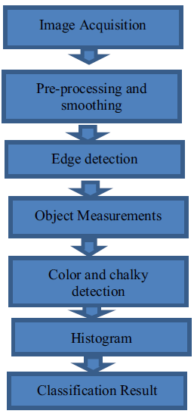
[3] Zahida Praveen et al, “ Assessment of Quality of Rice Grain using Optical and Image Processing Technique”, International Conference on Computing Methodologies Communication (ICCMC) 978-1-4244- 7164-5 ©2017 IEEE
In this Algorithm they have calculated the chalkiness and used various color models such as RGB and HSV color models
These features are analysed on the histogram to determine the quality of the rice grains
The results of the histogram is measured and listed in a table.
Results are based on area, length, width and chalkiness.
Advantage: Almost accurately calculates the percentage of chalky area of the rice grain
Disadvantage: Validation of the research relies on visual inspection

Slide 10
[4] Muhammad Junaid Asif et al., “Rice Grain Identification and Quality Analysis using Image Processing based on Principal Component Analysis” 978-1-5386-8204-3/18 ©2018 IEEE
Research on this paper shows an image processing-based solution to classify the different varieties of rice and its quality analysis using an approach based on the combination of principal component analysis and canny edge detection
The morphological features used for classification are eccentricity, major axis length, minor axis length, perimeter, area and size of the grains
Results obtained in terms of classification and quality analysis are 92.3% and 89.5% respectively
Advantage: Uses algorithms like Principal Component Analysis which makes the research robust
Disadvantage: The accuracy of the proposed system is very less

Slide 11
[5] Deepika Sharma et al, “Grain Quality Detection by using Image Processing for public distribution”, International Conference on Intelligent Computing and Control Systems 978-1-5386-2745 ©2017 IEEE
The work in this Research states that the processing of grains can also be done using Neural Network classifier
The work proposes classification through feature extraction keeping the features as Area, Major axis length, Minor axis length, Perimeter
The testing process involves Image Pre-Processing, Segmentation Image Binarization, NN Classifier
The grains are classified into ‘Good’, ‘Average’, and ‘Bad’ with an accuracy of 82%
Advantage: Most sturdy system which implements IoT and Image Processing which is useful for the society.
Disadvantage: No research done on the accuracy of the grain classification

Slide 12
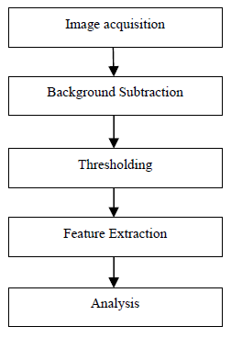
[6] Shraddha N. Shahane et al, “Grain Quality Assessment for Rationing System”, Online International Conference on Green Engineering and Technologies 978-1-5090-4556 ©2016 IEEE
The System which is proposed checks the quality of the Wheat Sample
using features such as size, shape, eccentricity, perimeter etc
In this Algorithm the steps which are involved to assess the
food grains are shown
The results obtained would be accurate and it gives a
cost effective solution for assessment of the food grains
Advantage: It replaces manual inspection by machine vision
Disadvantage: The idea is not reliable since it is not implemented

Slide 13
[7] Megha R. Siddagangappa et. Al, “Classification and Quality Analysis of Food Grains,” IOSR Journal of Computer Engineering (IOSR-JCE), Aug. 2014
Identification of rice varieties based on their characteristics has been done using Probabilistic Neural Network(PNN) approach
Three well known rice varieties were used in tests. This paper proposes a model that uses colour and geometrical features as attributes for classification
The grading of rice sample is done according to the size of the grain kernel and presence of impurities
A good classification accuracy is achieved using only 6 features, mean of RGB colours and 3 geometrical features. Tests on the system for the test sets show accuracy of 98% and grading of rice is 90% to 92%.
Advantage: Uses most advanced PNN algorithm which gives a high degree of accuracy
Disadvantage: The percentage of accuracy would have been more if Sobel edge detector was used instead of Canny edge detector in the pre-processing stage

Slide 14
Objective
The aim of this project is to develop a real-time application that can classify the type of grain given according to its quality. To do so, the following steps are followed
Capture the an image of the grain using a digital camera and store it in the database.
Perform the tasks of pre-processing, segmentation and feature extraction. Store the extracted features in the feature vector for training.
Build the neural network for training and recognizing the grain type and its quality.
Finally, test the system by giving different images as input.

Slide 15
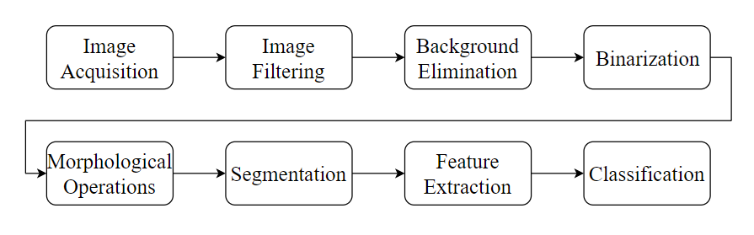
Methodology

Slide 16
References | Data set | Pre-Processing techniques | Extracted features | Color Spaces | Training | Criteria | Average accuracy
Syed Ali et al., (2019) | 103 rice Grains | Filter, dilation, ersion | Length, width, area, uneven particles, grains of other colors | RGB | N/A | Accuracy | 95%
Harpeet et., al (2019) | Mixed rice samples | Physical | Length, width, aspect ratio, chalkiness, texture | N/A | N/A | N/A | N/A
Parveen, et al., (2017) | 22 rice grains | Smoothing | Area, Length, Width, Chalkiness | RGB, HSV | N/A | Recognition rate | N/A
Junaid et al., (2018) | Varieties | Filtering | Length, width, aspect ratio, | grayscale | feed-forward neural network | Accuracy | 89.5%
Deepika et al., (2017) | Mixed Wheat Samples | Filtering, Noise Removal | Area, Major and Minor Axis Length, Perimeter | grayscale | Nil | Recognition rate | 75%
Sahane et al., (2016) | N/A | N/A | Area, length, perimeter | N/A | N/A | N/A | N/A
Megha. et al., (2014) | 12 types of grains | Filter, dilation, erosion | Colour, Geometrical | Grayscale | Probabilistic Neural Networks | Accuracy | 92%

Slide 17
References
[1] Qing Yao, Jianhua Chen, Zexin Guan, Chengxiao Sun, Zhiwei Zhu “Inspection of rice appearance quality using machine vision”, Global Congress on Intelligent Systems, 978-0-7695-3571-5/09, IEEE 2014.
[2] Yong Wu and Yi Pan “Cereal Grain Size measurement based on Image Processing Technology”, International Conference on Intelligent Control and Information Processing, August 13-15, 2015 - Dalian, China.
[3] Megha R. Siddagangappa, A. H. Kulkarni “Classification and Quality Analysis of Food Grains,” IOSR Journal of Computer Engineering (IOSR-JCE), Aug. 2014.

Slide 18
[4] Deepika Sharma et al “Grain Quality Detection by using Image Processing for public distribution”, International Conference on Intelligent Computing and Control Systems 978-1-5386-2745-7/17/ 2017
[5] Shraddha N. Shahane et al, “Grain Quality Assessment for Rationing System”, Online International Conference on Green Engineering and Technologies 978-1-5090-4556 ©2016 IEEE
[6] Harpreet Singh et al, “ Image Processing Techniques for Analysing Food Grains”, International Conference on Computing Methodologies Communication (ICCMC) 978-1-4244-7164-5 ©2019 IEEE
[7] Zahida Praveen et al, “ Assessment of Quality of Rice Grain using Optical and Image Processing Technique”, International Conference on Computing Methodologies Communication (ICCMC) 978-1-4244- 7164-5 ©2019 IEEE

Slide 19
Thank You

